Slide 1

Library management system + Student record management
Compiled By-ADITYA KUAMR TIWARI
Roll No. 2103490100005
Department – CSE

Slide 2
This mini project in C++ Library management system + Student record management is a console application without graphics developed using C++ Programming language. It is compiled in Dev C++ with the GNU Compiler.
In this you can perform Operations of real library or student management device in your computer.

Slide 3
Here you can perform functions like Add book, Add student record, update record of student or book, search any particular book or record. File handling has extensively used in this project for almost every function . So this project can guide you to understand C++ mini projects in a better ways.

Slide 4
The source code is well organised, and it has multiple comment lines to understand the project very easily.

Slide 5
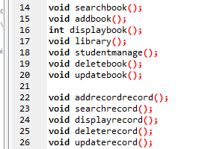
Have a look on these functions-

Slide 6
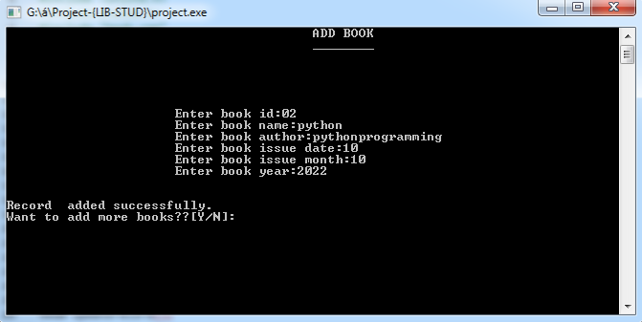
Funtions used in this mini project
void addbook( ) ; -This function is used to add a particular book with its respective data.

Slide 7
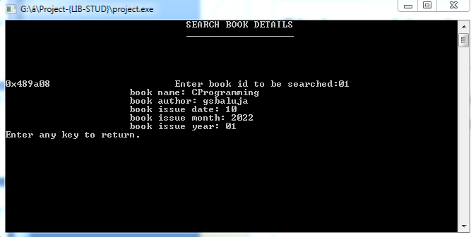
Void searchbook( ) – This particular function is used to search any book with the help of its book id.

Slide 8
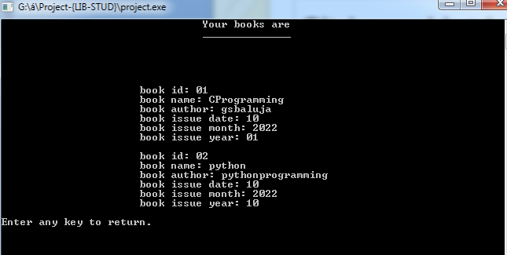
void displaybook( ) - This function helps to display all the book which are entered in the program.

Slide 9
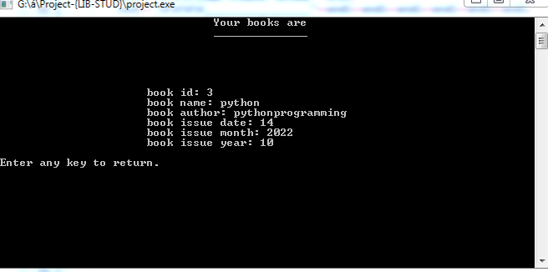
void deletebook( ) – This function is used to delete the book from the record. As show in snapshot only 1 record is left after deletion.

Slide 10
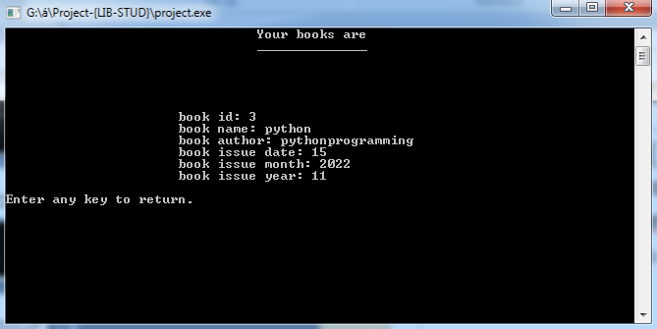
void updatebook( ) – This function is used to update the record of book. Basically if you entered entered any entery wrong then this function is helpful.

Slide 11
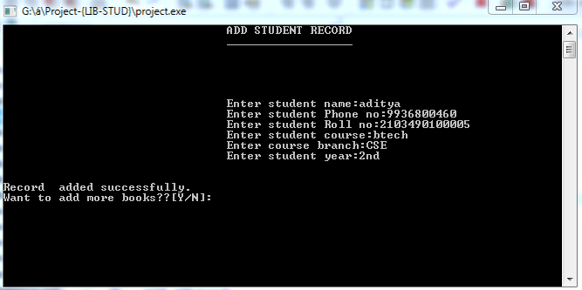
void addrecord( ) – This function helps to add any student record with his/her basic information.

Slide 12
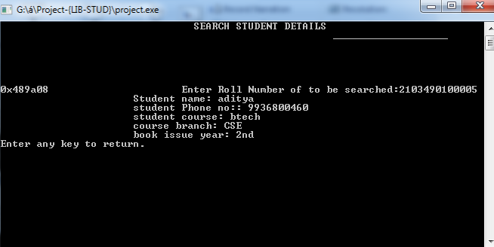
void searchrecord( ) – This particular function is used to search any record and print the details of that record.

Slide 13
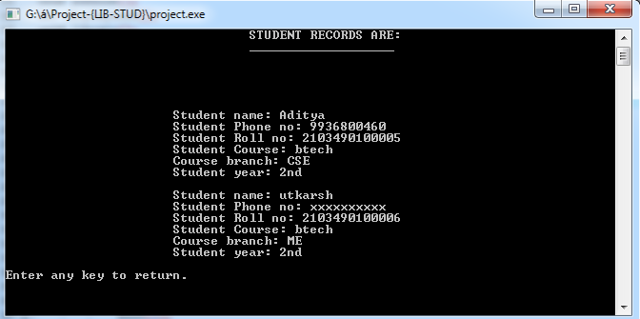
void displayrecord( ) – This function will show or print all the records saved in the program.

Slide 14
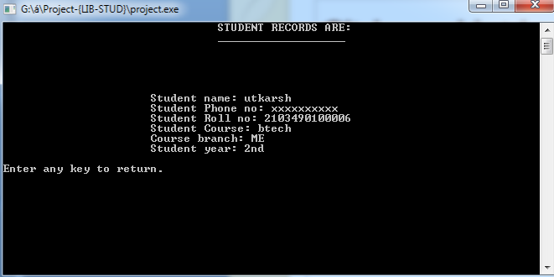
Void deleterecord( ) – This function is used to delete any record of student and after deletion it will show the remaining records.
Ex- I have deleted my record.

Slide 15
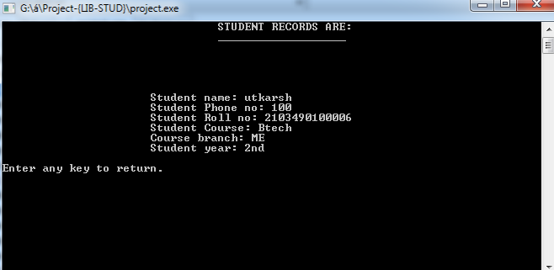
void updaterecord( ) – This function is used to update the record of the student.
Here I have updated the utkarsh’s Ph no.

Slide 16
THANK YOU

